Slide 1


Efficient FPGA Implementation of a Convolutional Neural Network for Radar Signal Processing
Authors: Jingchi Zhang, Yihao Huang, Huanrui Yang, Michael Martinez, Granger Hickman, Jeffrey Krolik, Hai Li
Affiliation: Duke University
Conference: 2021 IEEE 3rd International Conference on Artificial Intelligence Circuits and Systems (AICAS)
Presented to: Prof. Jean-Christophe
Prof. Audrey Martini
1

Slide 2
Table of Contents
01
Introduction
02
SaVi
03
Objectives
04
Constellations
05
Tasks
06
Observation and Results
07
Conclusion
2

Slide 3
01
INTRODUCTION
3

Slide 4
INTRODUCTION(1)
A CNN is a type of artificial neural network specifically designed to process and analyze grid-like data structures.
Consists of Convolution layers, Activation Functions, Pooling layers, FCL, and an output Layer.
CNN has been successfully applied in many domains achieving state of the art performance in recognizing and classifying images.
CNN heavily relies on the quality and quantity of the training data.
Application of CNNs to radar signal processing is challenging due to the lack of training data.
4
Notes:
Goal: Improve radar signal processing by utilizing Convolutional Neural Networks (CNNs) for adaptive beamforming (ABF).
Objective: Enhance target detection and clutter suppression in urban terrains using FPGA-based implementations.
Neural networks, particularly convolutional neural networks (CNNs), have demonstrated success across various fields.

Slide 5
INTRODUCTION(2)
Due to the limitations of conventional processing methods in complex environments
This paper target the use of CNNs to improve adaptive beamforming for detection of low, slow, small unmanned aerial systems (UASs) in urban terrain.
This Paper explores the application of Convolutional Neural Networks (CNNs) to enhance adaptive beamforming (ABF) in radar systems.
Adaptive array processing is crucial in radar signal processing to maximize the Signal-to-Noise Ratio (SINR).
5
Notes:
The implementation focuses on optimizing performance and energy efficiency
Ground-moving target indicator (GMTI) radars in complex terrains face multipath scattering, non-stationary clutter, and array miscalibration.
Initial processing is typically performed using
simple plane-wave, point target, constant
velocity assumptions to beamform the receive antenna array

Slide 6
02
METHODOLOGY
3

Slide 7
Situ “pattern of life” radar data used to train the CNN model.
ResNet-like CNN structure used to classify components from blind source separation (BSS) outputs.
Classification results identify clutter components to improve SINR on targets of interest.
FPGA implementation was considered to reduce power consumption while maintaining radar signal processing speed.
Utilized High-Level Synthesis (HLS) for high-performance and energy efficiency.
6
Notes:
CNN model learns the urban clutter and noise environment.

Slide 8
The CNN Model Design
ResNet10 model with 4 two-layer residual blocks.
Constrained convolution block size to 3×3 for computational efficiency.
Two Processing Element (PE) designs were developed: conventional and systolic.
7
Notes:
10-layer ResNet model chosen to balance classification accuracy and inference speed.
Conventional PE design uses standard convolution operations with input buffers.Systolic PE design utilizes a SIMD vector accumulation format for efficient data flow.

Slide 9
02
SaVi
8

Slide 10
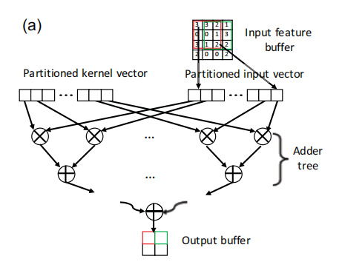
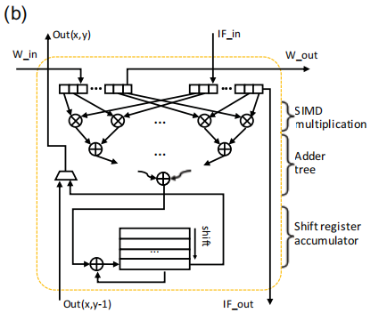
SaVi (1)
Conventional PE design overview
Systolic PE design overview
9

Slide 11
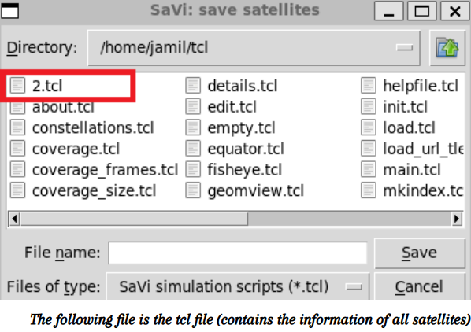
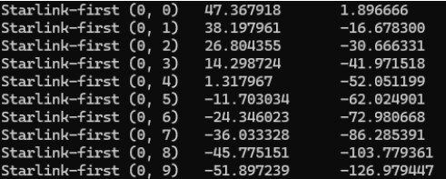
SaVi (2)
Allow extraction of the spherical coordinates and orbital parameters of each satellite in the chosen constellation
Step1 : Save satellites parameters in tcl file
Step2: Use Ubuntu to extract data
10

Slide 12
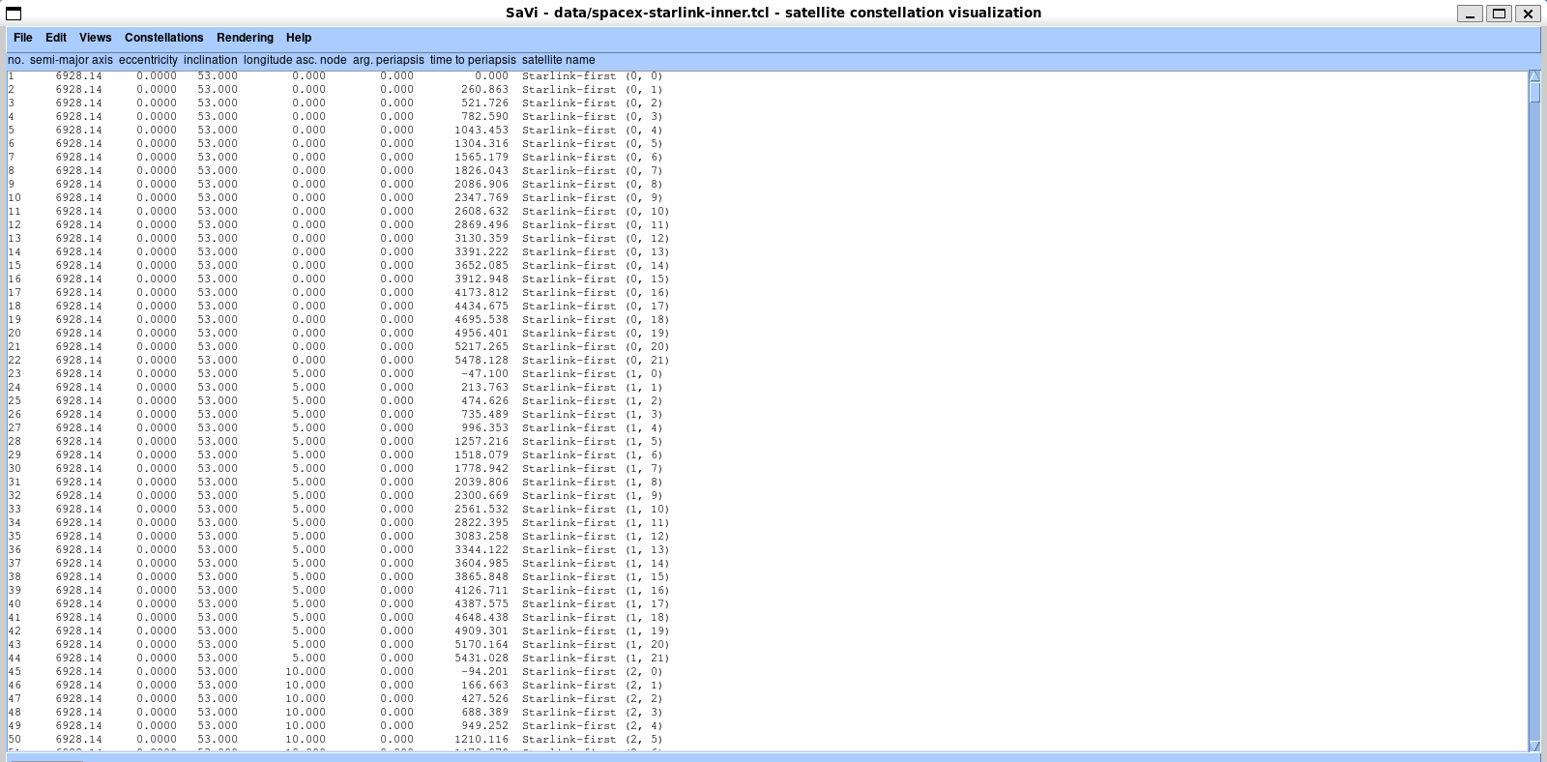
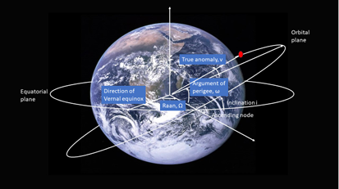
SaVi (3)
SaVi’s Orbital Parameters
Orbital Parameters
11

Slide 13
03
Objectives
12

Slide 14
Objectives
Focus on the LEO satellite networks to enhance communication making it faster and more reliable.
Use SaVi to track and understand the orbital paths of satellites in real-time.
Gain insights into the movements and coverage resulting a comprehensive understanding of satellite behavior and communication.
Try to build a grid of Inter Satellite Links (ISL) by utilizing extracted data from SaVi.
13

Slide 15
04
Constellations
14

Slide 16
Constellations (1)
Group of satellites that are strategically positioned in orbits around the Earth.
StarLink
Telesat
lunched by spaceX
Consists of 1584 satellites.
Orbit the earth at 550km above the earth
lunched by spaceX
consists of 126 satellites.
Orbit at 1,000 km
1
2
Project Kuiper
lunched by Amazon
consists of 1296 satellites.
Orbit at 500 km
3
These constellations aim to provide high-speed Internet services with low latency and an innovative global network.
15

Slide 17
Constellations (2)
Telesat constellation is composed of Polar Telesat and Inclined Telesat.
Polar Telesat consists of satellites orbiting the Earth in near-polar orbits which results in covering the entire globe including the polar regions.
Inclined Telesat consists of satellites in which their orbits are inclined at an angle with respect to the equatorial plane of the Earth.
Telesat provides global coverage.
16

Slide 18
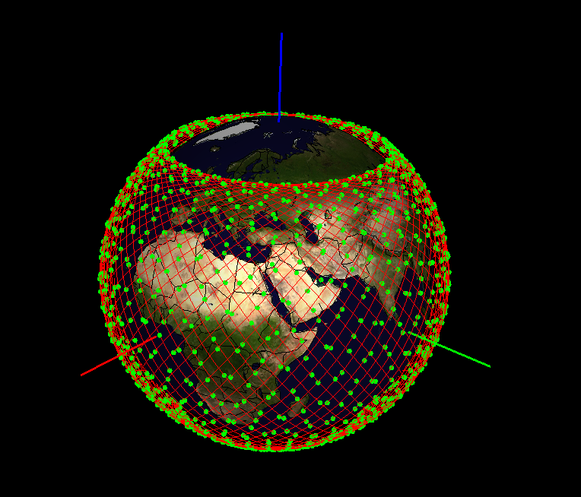
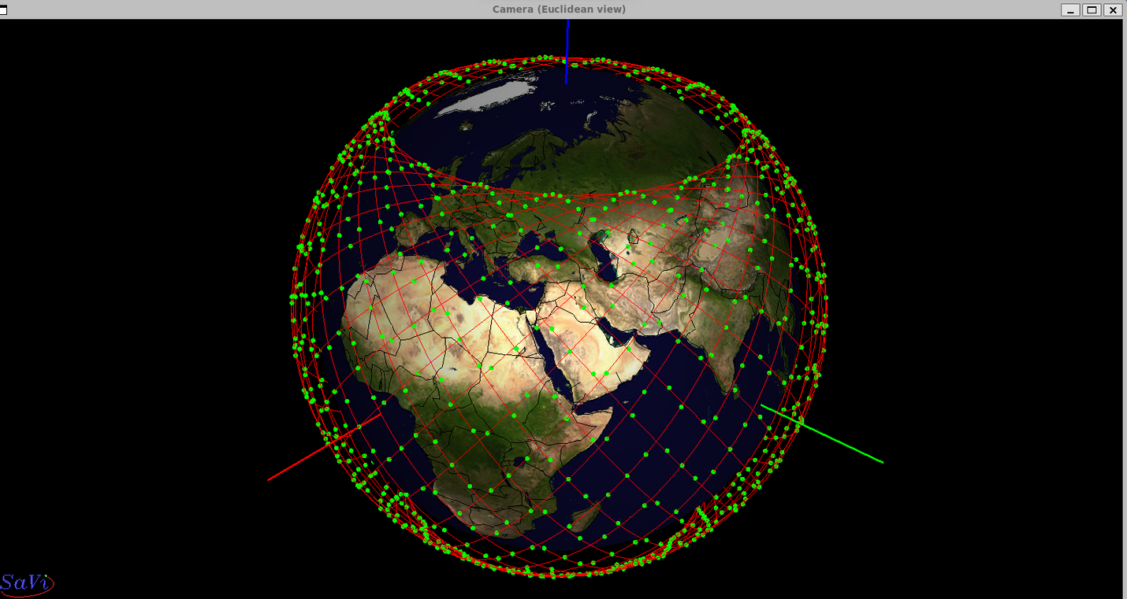
Constellations (3)
Project Kuiper
Constellation
StarLink Constellation
17

Slide 19
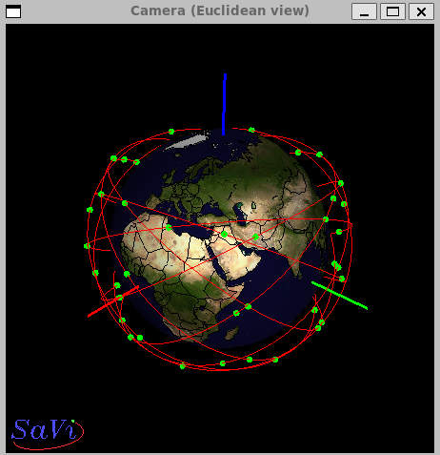
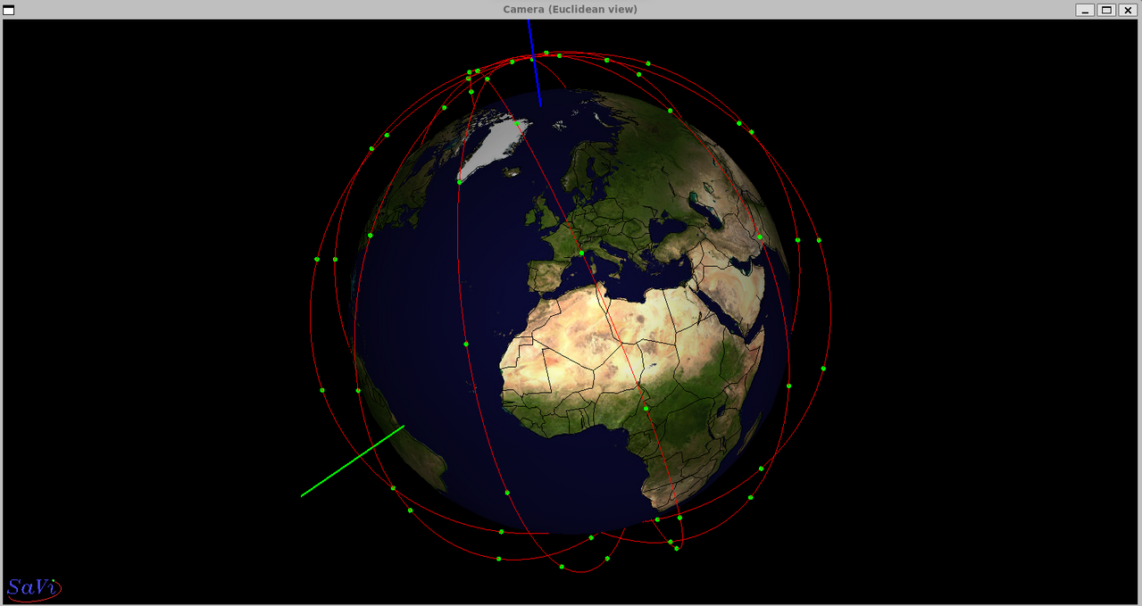
Constellations (4)
Inclined Telesat Constellation
Polar Telesat
Constellation
18

Slide 20
05
Tasks
19

Slide 21
Tasks
Find 3 time slots of all constellations when 1 satellite from each constellation is right above Paris in the Fisheye view.
Find the timestamp of each satellite in the time zone of France.
Search for the neighboring satellites.
Build a Grid
Find the closest satellite to Los Angeles and Moscow at the particular time slots.
Find the shortest path between the satellite over Paris and that over Los Angeles for all constellations using Dijkstra’s Algorithm .
Compute RTT between start and end satellites signals
20

Slide 22
06
Observations and Results
21

Slide 23
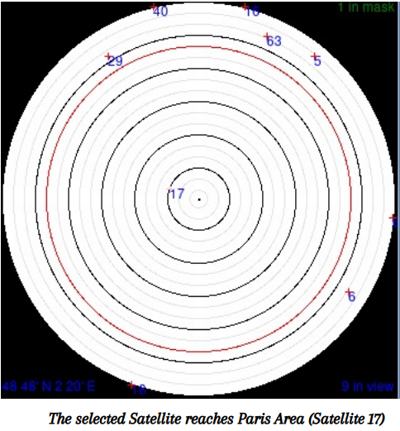
Time Slot Selection (1)
Select a satellite from each constellation.
Start simulation.
Observe the satellite when it starts covering Paris using local fisheye and the 3D camera view.
Stop simulation and obtain time slot.
22

Slide 24
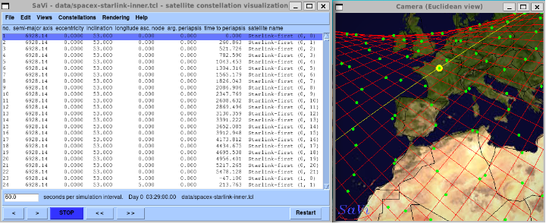
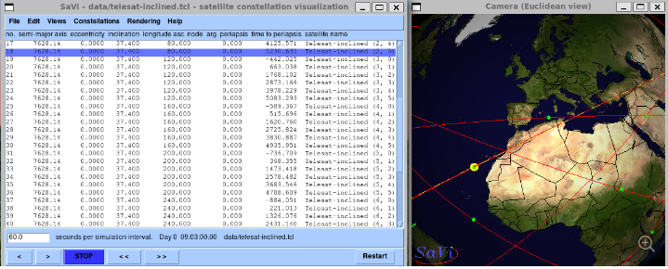
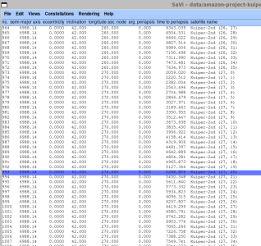
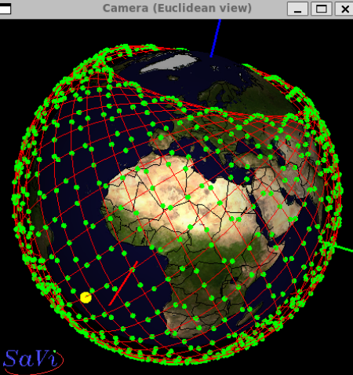
Time Slot Selection (2)
Starlink
Inclined Telesat
Project-Kuiper
Time slot: 03:29:00.00
Time slot: 09:03:00.00
Time slot: 00:17:00.00
23

Slide 25
Timestamps in time zone
Extract time of periapsis parameter from SaVi.
Get the current UTC time as the reference time.
Add time of periapsis to the current UTC time.
Convert the UTC times of periapsis to France time (CET).
24

Slide 26
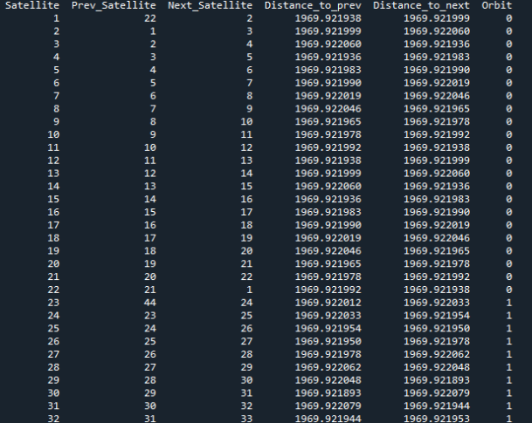
Satellites’ Neighbours in same Orbit
Convert the spherical coordinates of each satellite to cartesian.
Compute the Euclidean distances between all pairs of satellites.
Search for the neighboring satellites within the same orbit for each satellite.
25

Slide 27
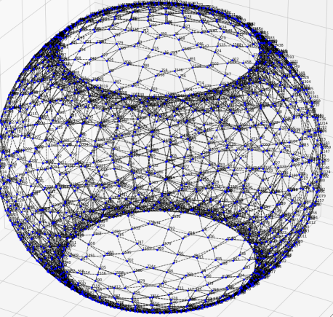
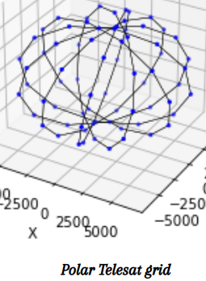
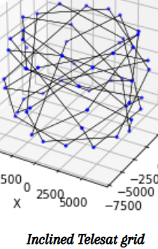
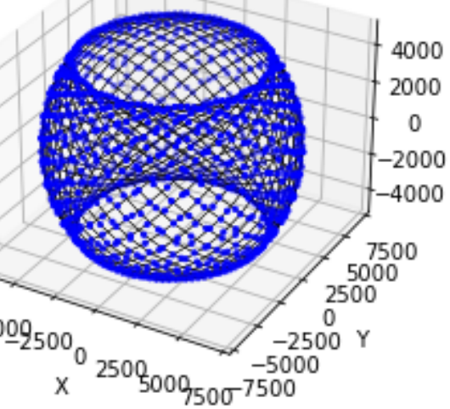
Grid
Try to build a spherical and fully connected grid using the computed distances between satellites within the same orbit for each constellation.
Starlink
Telesat
Project Kuiper
26

Slide 28
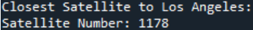
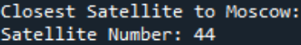
Finding Closest Satellite (1)
Define the latitude and longitude of Los Angeles and Moscow.
Convert their coordinates to Cartesian.
Compute the Euclidean distance between each city with all the satellites in the grid of StarLink constellation.
Choose the satellite with the minimum distance.
StarLink Output: Closest to Los Angeles :
Closest to Moscow :
27

Slide 29
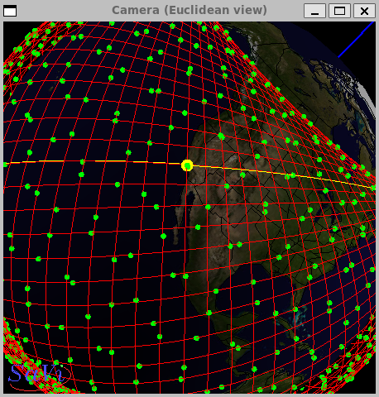
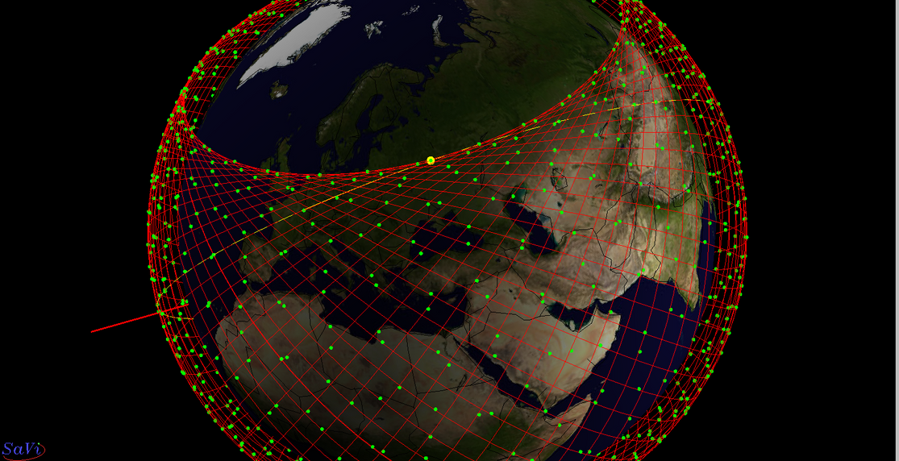

Finding Closest Satellite (2)
Closest Satellite to LA (Satellite 1178)
Closest Satellite to Moscow (Satellite 44)
28

Slide 30
Shortest Path
Dijkstra's algorithm is a fundamental algorithm used to find the shortest paths between nodes in a graph.
Run Dijkstra's algorithm with the source vertex being the satellite over Paris to calculate the shortest path from this satellite to all other satellites in the graph.
Retrieve the shortest path from the satellite over Paris to the satellite over Los Angeles and that over Moscow.
Shortest path to Los Angeles:
Shortest path to Moscow:
29

Slide 31
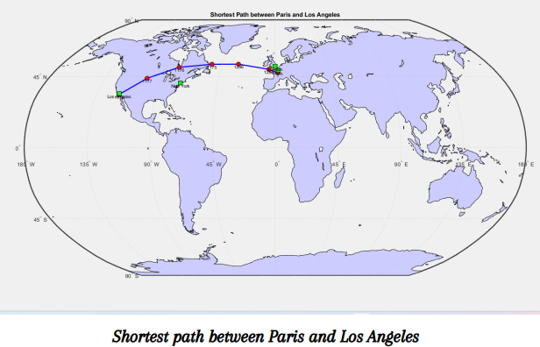
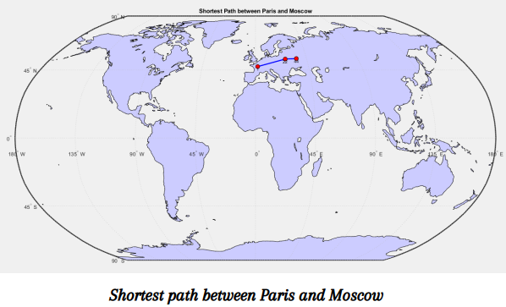
Shortest Path
Starlink:
30

Slide 32
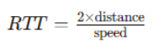
RTT (1)
Calculate RTT using the formula :
Distance between the satellite over Paris and the one closest to Los Angeles and to Moscow respectively.
Speed of light in vacuum.
Add the time of signal traveling from the satellite to the ground station at both ends.
31

Slide 33
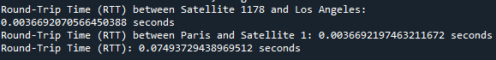
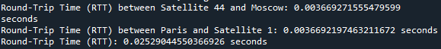
RTT (2)
RTT to Los Angeles : 74.9 ms
RTT to Moscow: 25,29 ms
LEO satellites result in smaller RTT compared to the GEO satellites since they have shorter signal propagation distances due to their lower orbital altitude.
32

Slide 34
RTT (3)
Comparing to other round trip time (RTT) values for satellite communication between Paris and Los Angeles, considering different types of satellites:
Geostationary Satellite:
RTT: Approximately 238 milliseconds
Low Earth Orbit (LEO) Satellite:
RTT: Varies depending on the specific orbit and configuration of the LEO satellite constellation being used. It could range from around 20 milliseconds to 100 milliseconds or more.
33

Slide 35
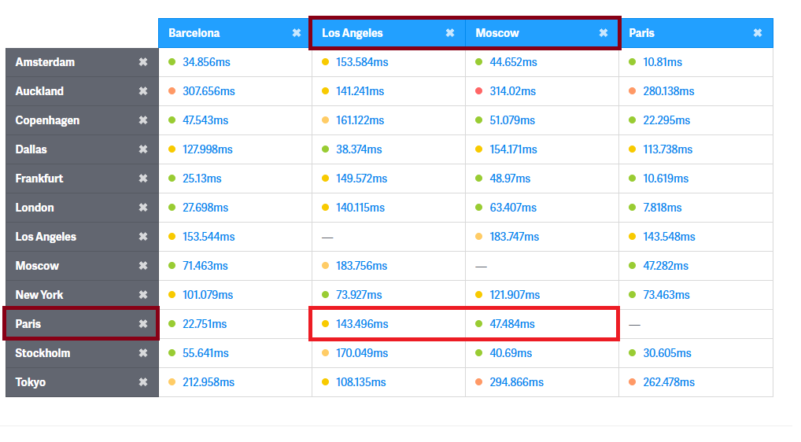
RTT (4)
Comparison with terrestrial networks, ping times between distant locations can vary significantly depending on many factors.
34

Slide 36
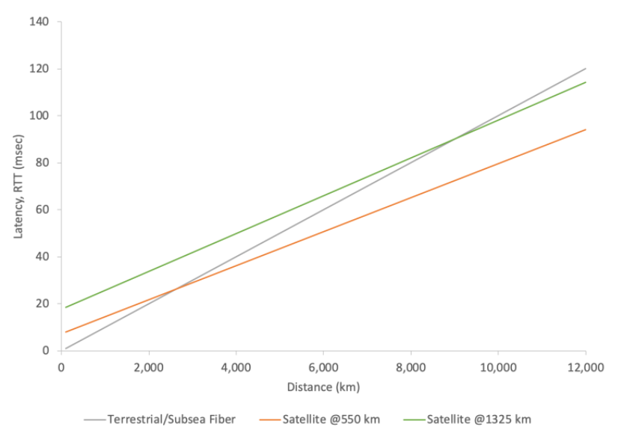
RTT (5)
35

Slide 37
07
Conclusion
36

Slide 38
Conclusions
Our project underlines the importance of advancements in constellation design, ISL management.
(LEO) satellite networks offer reduced latency and improved reliability
1
2
What strategies and technologies are most effective for integrating LEO satellite networks with existing terrestrial communication networks to create a seamless global communication system?
How to build an optimized version of the ISL grid?
3
4
37

Slide 39
References
LEO Satellite Networking Relaunched: Survey and Current Research Challenges Cedric Westphal, Lin Han, Richard Li
https://savi.sourceforge.io/download/
https://savi.sourceforge.io/manual
https://frankrayal.com/2021/07/07/latency-in-leo-satellites-vs-terrestrial-fiber/
38

Slide 40

Thanks!
Do you have any questions?
39

